Slide 1

Data Structures and Algorithms: Essential Concepts
In this presentation, we'll explore essential concepts in Data Structures and Algorithms (DSA), focusing on key data structures like Stack and Queue. We'll begin with an overview of DSA and Abstract Data Types (ADTs), then dive into the unique characteristics and applications of Stack and Queue, comparing their methods, advantages, and limitations. We'll also examine two common sorting algorithms—Bubble Sort and Quick Sort—analyzing their efficiencies and use cases. Finally, we'll discuss shortest path algorithms, including Dijkstra's algorithm, and their importance in networked systems.

Slide 2


Mastering Data Structures and Algorithms
Welcome to our journey through Data Structures and Algorithms (DSA). This presentation will explore key concepts, their importance, and practical applications in programming.
We'll dive into Abstract Data Types (ADTs) and focus on the Stack data structure.

Slide 3

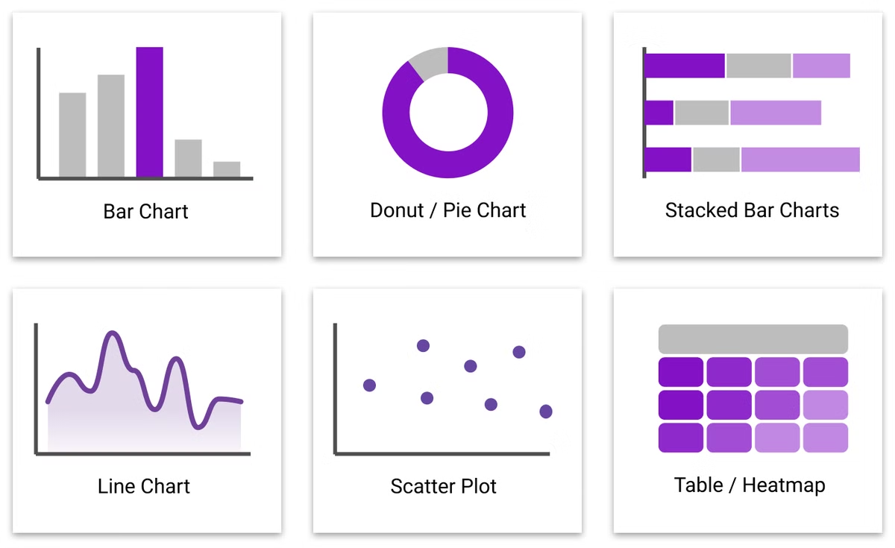
What is DSA?
Data Structures
Organize and store data efficiently. Examples include arrays, linked lists, and trees.
Algorithms
Step-by-step procedures for solving problems. They manipulate data within structures.
DSA Combined
DSA forms the backbone of efficient programming. It optimizes data management and problem-solving.

Slide 4


Importance of DSA
1
Efficiency
2
Problem Solving
3
Career Growth
DSA optimizes code performance. It reduces time and space complexity in programs.
DSA enhances logical thinking. It provides frameworks for tackling complex computational challenges.
Strong DSA knowledge is crucial. It's often tested in technical interviews for programming jobs.

Slide 5
What is ADT?
Definition
Abstraction
Examples
ADT is a theoretical concept. It defines data and operations without implementation details.
ADTs hide complex operations. They provide a simple interface for data manipulation.
Common ADTs include List, Stack, and Queue. They specify behavior without concrete implementation.

Slide 6


The Role of ADT in DSA
Abstraction Layer
1
ADTs provide a high-level view. They separate the what from the how in data manipulation.
2
Design Flexibility
ADTs allow multiple implementations. Developers can choose the most efficient structure for their needs.
Code Reusability
3
ADTs promote modular design. They enable the creation of reusable and maintainable code.

Slide 7


What is a Stack ADT?
LIFO Principle
Conceptual Model
Abstract Operations
Stack follows Last-In-First-Out order. The last element added is the first to be removed.
Think of a stack of plates. You can only add or remove from the top.
Stack ADT defines push, pop, and peek. These operations manage data without specifying implementation.

Slide 8

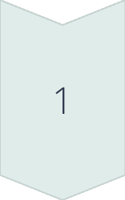
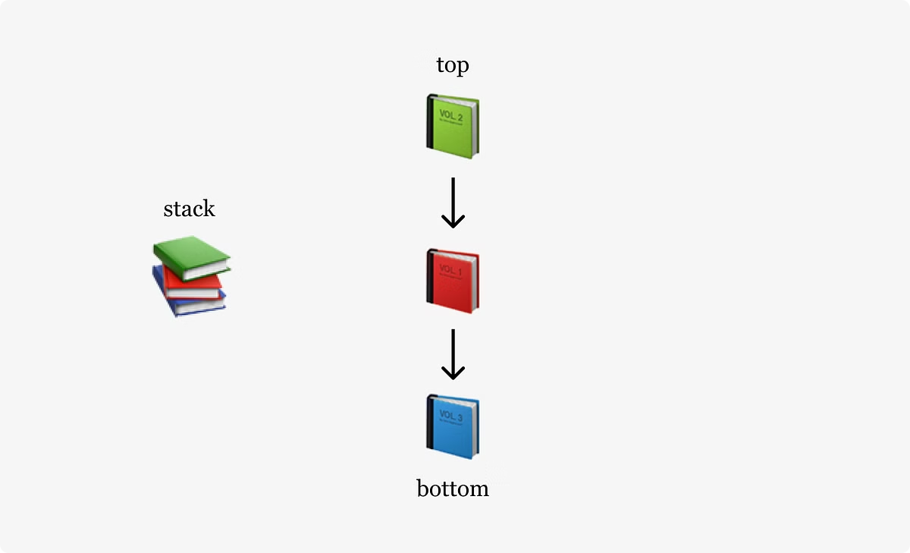
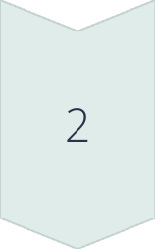
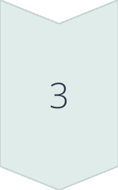
Main Functions of a Stack
Push
Adds an element to the top. It increases the stack size by one.
Pop
Removes the top element. It decreases the stack size by one.
Peek
Views the top element. It doesn't modify the stack structure.

Slide 9


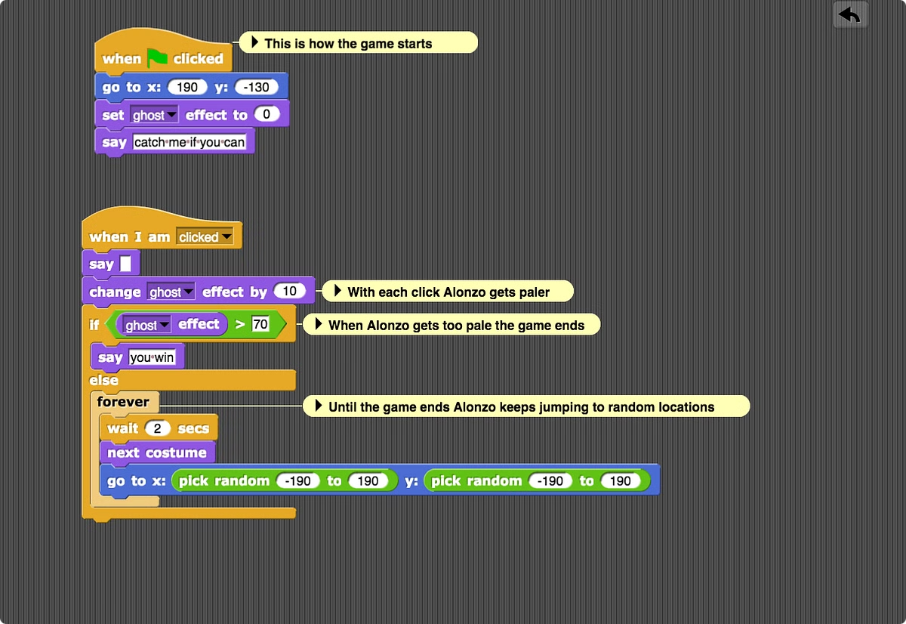


Benefits of Using Stack in Programming
Memory Efficiency
Stack allocates and deallocates memory automatically. It optimizes memory usage in programs.
Recursive Algorithms
Stacks manage function calls in recursion. They keep track of return addresses and local variables.
Undo Functionality
Stacks can store previous states. This enables easy implementation of undo features in applications.

Slide 10

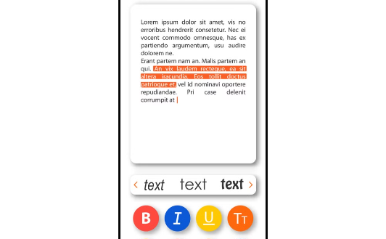
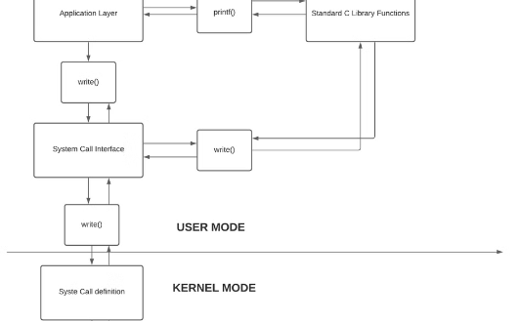
Real-life Applications of Stack
Browser History
Undo in Editors
Function Calls
Web browsers use stacks for navigation. The back button pops previous pages from the history stack.
Text editors implement undo with stacks. Each edit is pushed, allowing users to revert changes.
Programming languages use call stacks. They manage function execution and local variable storage.

Slide 11


Limitations of Stack
Limited Access
Only the top element is directly accessible
Fixed Size
Some implementations have a maximum capacity
Overflow Risk
Pushing beyond capacity can cause stack overflow
Underflow Risk
Popping from an empty stack can cause errors

Slide 12

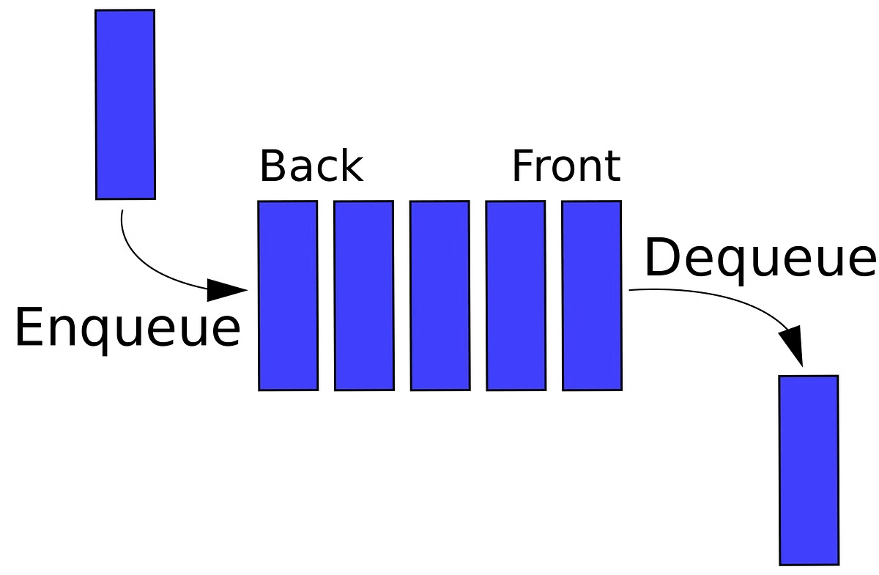
Understanding Queue Data Structure
Queue is a fundamental data structure in computer science. It follows the First-In-First-Out (FIFO) principle, essential for managing data in various applications. This presentation explores Queue's concepts, functions, and comparisons with Stack.

Slide 13

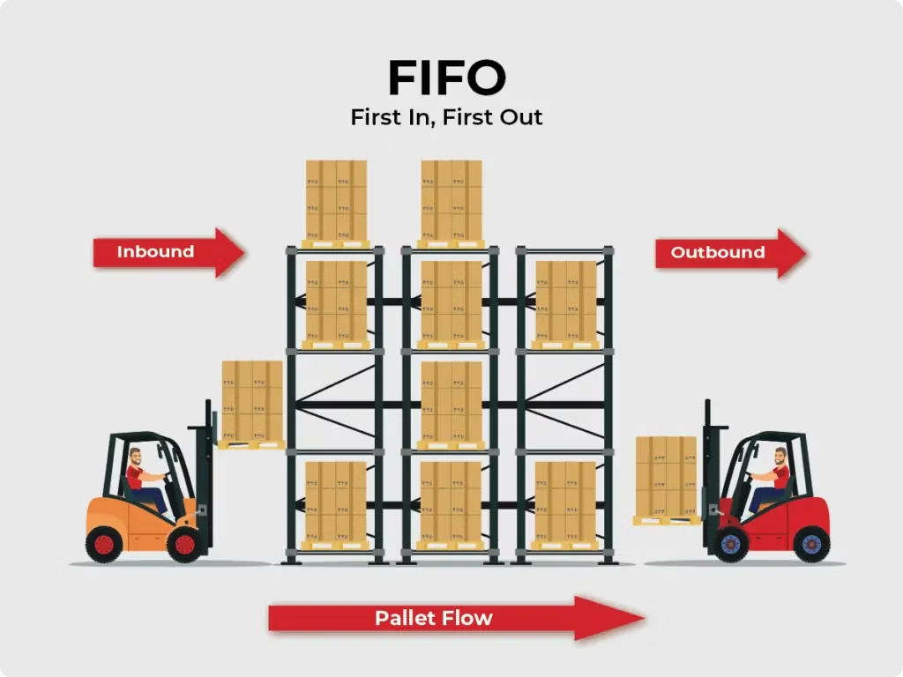
What is a Queue ADT?
1
FIFO Principle
Queue follows First-In-First-Out. Elements are added at one end and removed from the other.
2
Abstract Data Type
Queue ADT defines behavior without specifying implementation details. It provides a blueprint for queue operations.
3
Linear Structure
Elements in a queue are arranged in a linear sequence. This ordering is maintained throughout operations.

Slide 14

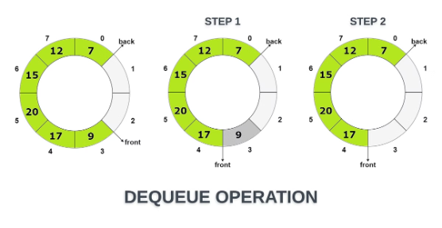




Main Functions of a Queue
Enqueue
Dequeue
Front
IsEmpty
Adds an element to the rear of the queue. It expands the queue's size.
Removes the front element from the queue. It decreases the queue's size.
Returns the element at the front without removing it. It's useful for peeking.
Checks if the queue is empty. It helps prevent dequeue operations on an empty queue.

Slide 15

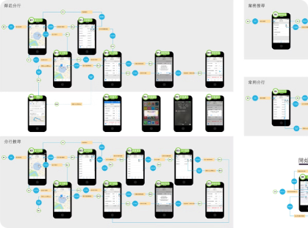



Real-world Applications of Queue
Banking Systems
Print Job Spooling
Traffic Management
Manages customer service order in banks. Ensures fair and efficient customer handling.
Organizes print jobs in order of request. Prevents conflicts in multi-user printing environments.
Controls traffic light systems. Optimizes vehicle flow through intersections based on waiting time.

Slide 16
Queue in Computing Systems
Data Queueing
Task Scheduling
Breadth-First Search
Buffers data packets in network routers. Ensures orderly transmission of information across networks.
Manages process execution in operating systems. Prioritizes tasks based on arrival time and importance.
Implements graph traversal algorithms. Explores neighboring nodes in level order for efficient pathfinding.

Slide 17

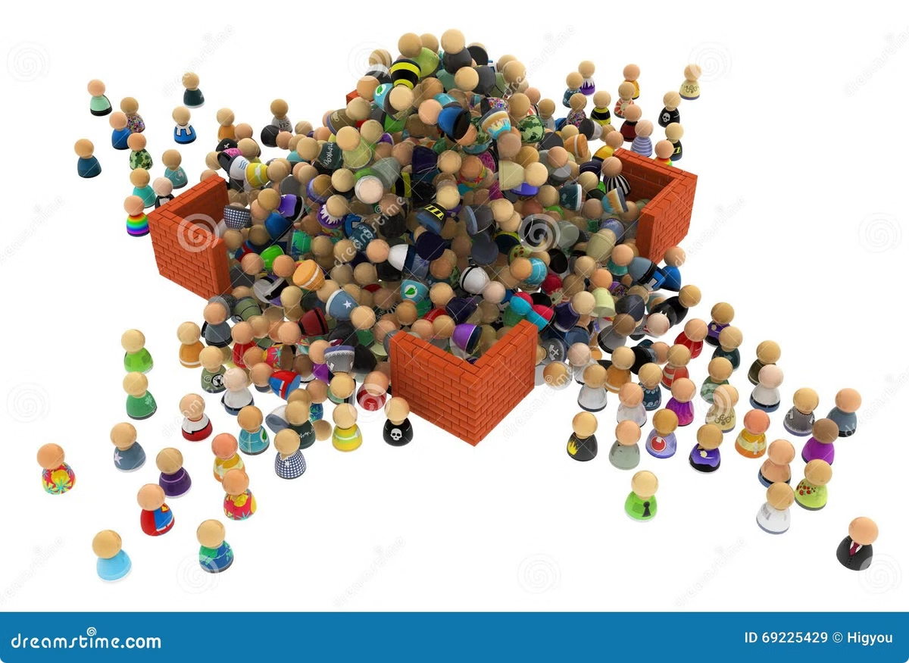
Limitations of Queue
Fixed Size
Array-based implementations have a maximum capacity. This can lead to queue overflow in high-demand scenarios.
No Random Access
Elements can only be accessed from the front. This limits flexibility in data retrieval.
Memory Overhead
Linked list implementations require additional memory for node pointers. This can be inefficient for large datasets.
Dequeue Complexity
Removing elements from the front can be slow in certain implementations. This may impact performance in time-critical applications.

Slide 18

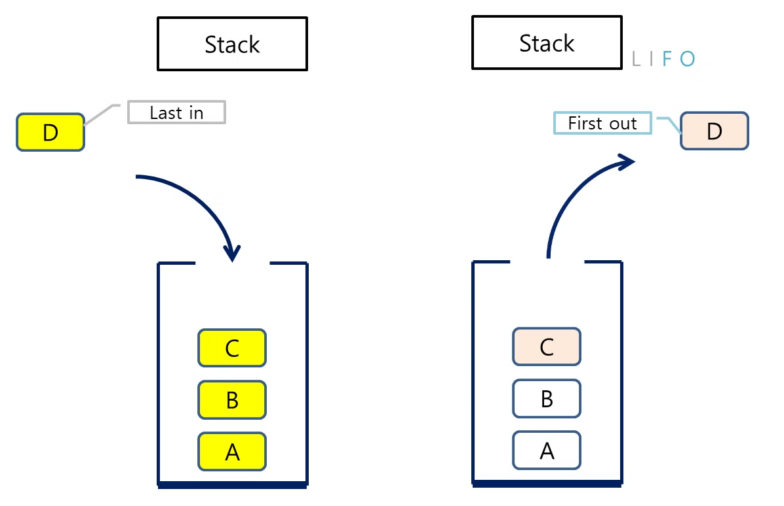
Comparison of Stack and Queue Operations
Aspect
Stack
Queue
Insertion
Push (top)
Enqueue (rear)
Deletion
Pop (top)
Dequeue (front)
Order
LIFO
FIFO
Access
Top element
Front element

Slide 19
Different Applications of Stack and Queue
Stack Applications
Queue Applications
Hybrid Uses
Function call management, undo mechanisms in editors, and bracket matching in compilers.
CPU scheduling, disk scheduling, and handling asynchronous data transfer between processes.
Implementing complex algorithms like breadth-first (queue) and depth-first (stack) searches in graphs.

Slide 20

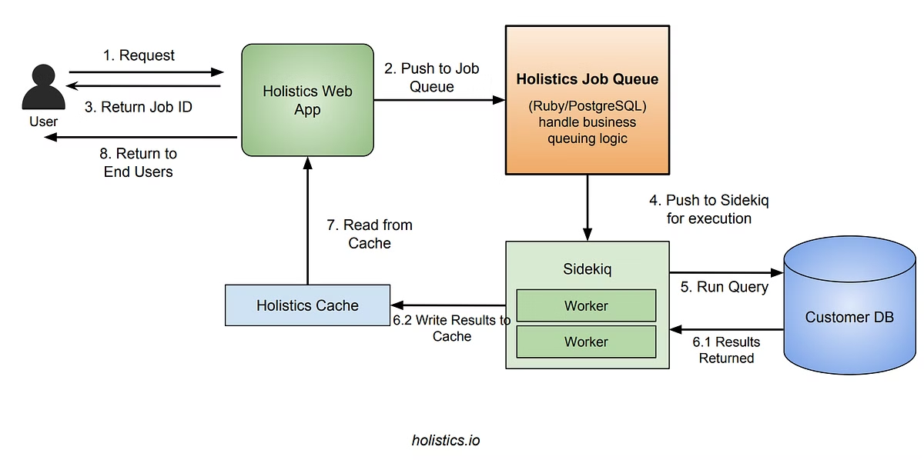
Advantages of Queue over Stack
1
Fair Processing
Ensures all elements are processed in order of arrival. Ideal for fair resource allocation.
2
Predictable Behavior
FIFO principle makes queue operations more predictable. Useful in time-sensitive applications like real-time systems.
3
Efficient for Sequential Access
Optimized for scenarios requiring sequential data processing. Perfect for streaming data or buffering.

Slide 21


Implementing Stacks and Queues: Efficient Data Structures
Stacks and queues are fundamental data structures in computer science. They offer different implementation methods, each with unique advantages and trade-offs. Understanding these approaches is crucial for efficient algorithm design and optimization.

Slide 22

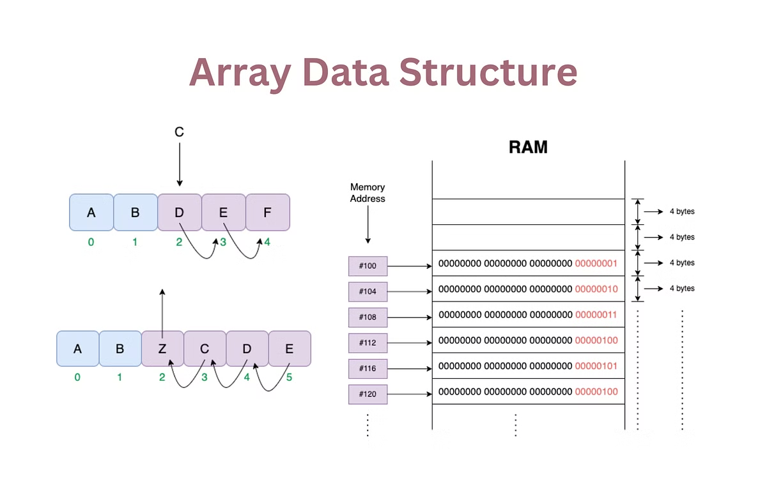
Array-Based Implementation
Fixed Size
Array-based implementations have a predetermined capacity. This limitation requires careful planning to avoid overflow.
Fast Access
Direct indexing allows for O(1) time complexity in push and pop operations. This speeds up element manipulation.
Memory Efficiency
Arrays use contiguous memory blocks. This reduces memory overhead and improves cache performance.

Slide 23
Linked List-Based Implementation
Dynamic Size
Memory Usage
Insertion Efficiency
Linked lists can grow or shrink as needed. This flexibility accommodates varying data sizes without preallocation.
Each node requires additional memory for pointers. This increases overall memory consumption compared to arrays.
Adding elements is efficient, with O(1) time complexity. This makes linked lists ideal for frequent insertions.

Slide 24
Circular Queue Implementation
1
Space Optimization
Circular queues reuse empty spaces. This efficient design maximizes the use of allocated memory.
2
Wraparound Technique
Elements can be added at the end and removed from the front cyclically. This eliminates the need for shifting elements.
3
Fixed Capacity
Like array-based implementations, circular queues have a predetermined size. Careful capacity planning is essential.

Slide 25

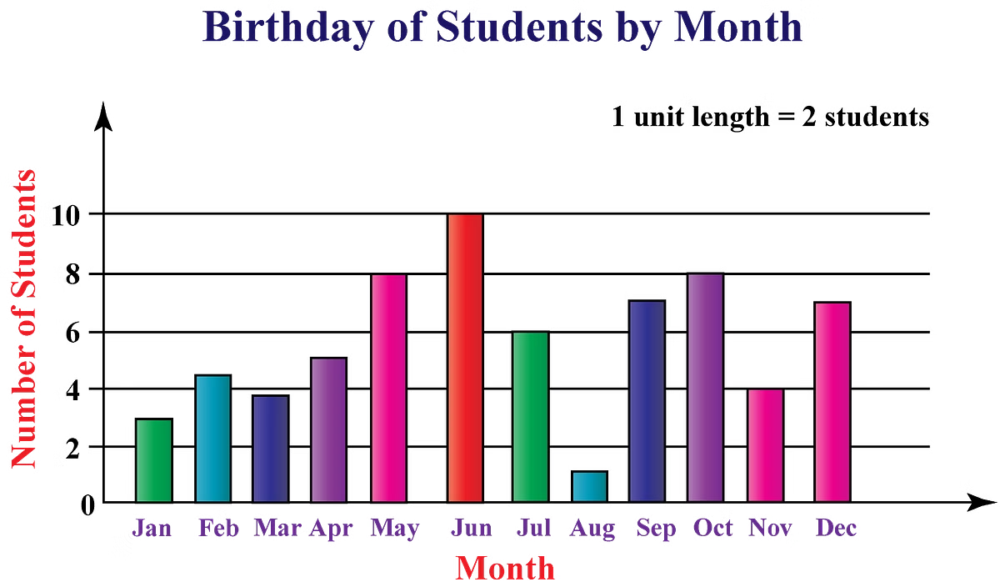
Performance Comparison
Implementation
Time Complexity (Push/Pop)
Space Efficiency
Flexibility
Array-based
O(1)
High
Low
Linked List-based
O(1)
Medium
High
Circular Queue
O(1)
High
Medium

Slide 26





Use Cases and Applications
Undo Functionality
Stacks are ideal for implementing undo features in software applications. They efficiently store and retrieve previous states.
Print Job Management
Queues are perfect for managing print jobs. They ensure first-come-first-served order in document processing.
Network Packet Routing
Circular queues are used in network routers. They efficiently manage packet buffers with limited memory.

Slide 27


Implementation Considerations
1
Memory Constraints
Consider available memory when choosing an implementation. Array-based structures are preferable for memory-constrained environments.
2
Operation Frequency
Analyze the frequency of push and pop operations. Linked lists excel in scenarios with frequent insertions and deletions.
3
Data Size Variability
Assess the variability of data size. Linked list-based implementations handle dynamic data sizes more efficiently.

Slide 28

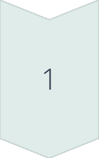

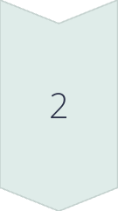
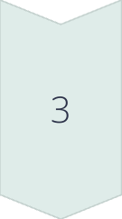
Future Trends and Optimizations
Cache-Aware Implementations
Future optimizations will focus on cache-friendly designs. This will improve performance in modern processor architectures.
Concurrent Data Structures
Development of lock-free and wait-free implementations will continue. These will enhance performance in multi-threaded environments.
Quantum Computing Adaptations
Research into quantum-compatible data structures will emerge. This will prepare for the advent of quantum computing technologies.

Slide 29

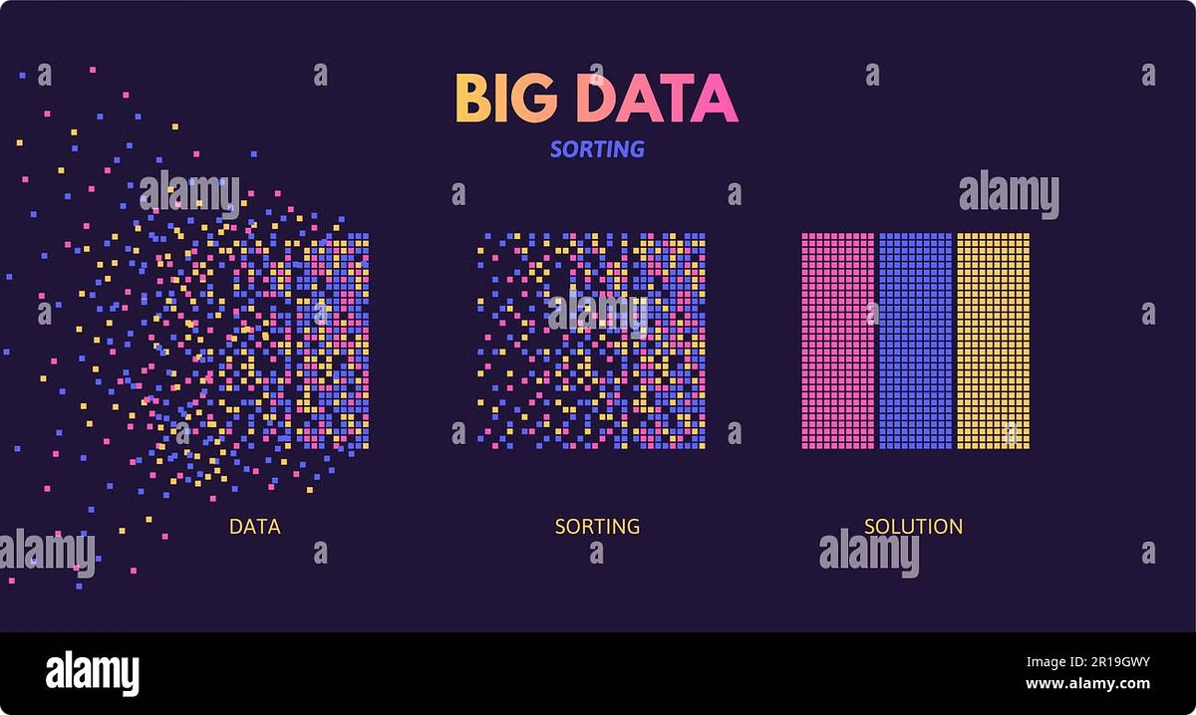
Introduction to Sorting Algorithms
Sorting algorithms are fundamental in computer science. They organize data efficiently, enabling faster searches and optimized processing. Understanding these algorithms is crucial for developing efficient software systems and solving complex computational problems.

Slide 30


Bubble Sort - Introduction
1
Step 1: Compare Adjacent Elements
Start with the first two elements. Compare and swap if out of order.
2
Step 2: Move to Next Pair
Shift one position right. Repeat comparison and swapping if necessary.
3
Step 3: Complete a Pass
Continue until the end of the list. The largest element "bubbles" to the top.
4
Step 4: Repeat
Perform multiple passes until no more swaps are needed. The list is now sorted.

Slide 31

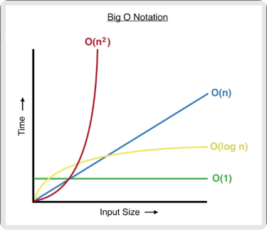
Bubble Sort - Complexity
Time Complexity
Space Complexity
Stability
Worst and average case: O(n^2). Best case (already sorted): O(n).
O(1) - only requires a constant amount of additional memory space.
Bubble Sort is stable, maintaining the relative order of equal elements.

Slide 32
Advantages and Disadvantages of Bubble Sort
Advantages
Disadvantages
Simple to understand and implement
Inefficient for large datasets
Requires minimal additional memory
Poor time complexity (O(n^2))
Performs well on small datasets
Excessive number of element swaps

Slide 33

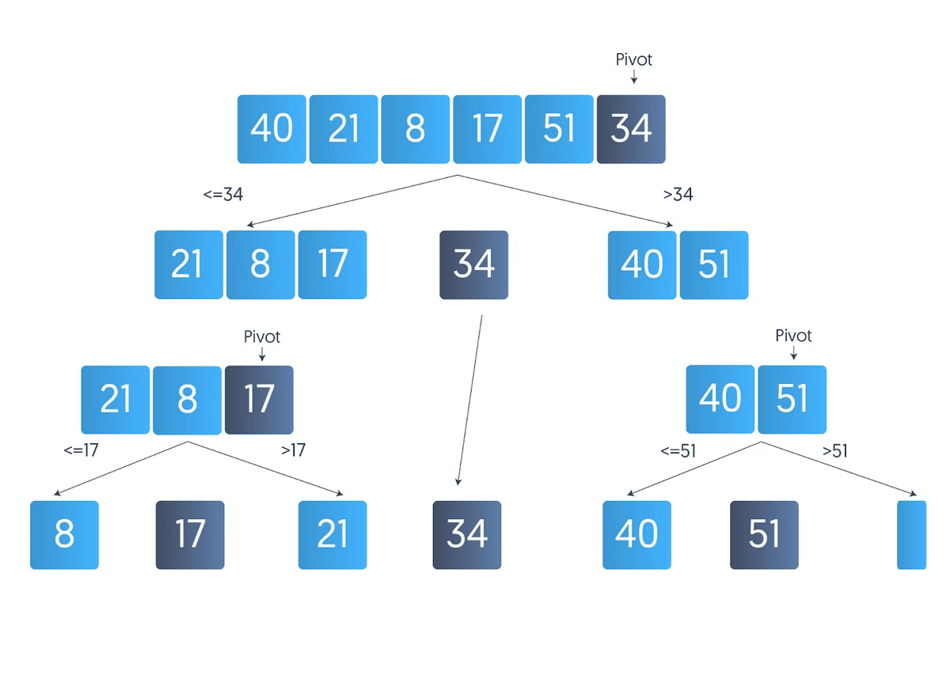
Quick Sort - Introduction
1
Choose Pivot
Select a pivot element from the array, often the last or a random element.
2
Partitioning
Rearrange elements, smaller to left, larger to right of the pivot.
3
Recursion
Apply Quick Sort recursively to the sub-arrays on both sides of the pivot.
4
Combine
The sorted sub-arrays and pivot form the final sorted array.

Slide 34

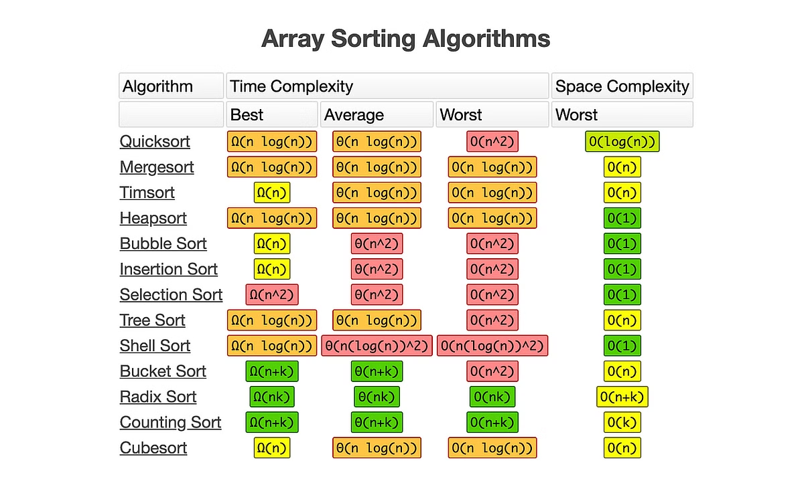
Quick Sort - Complexity
Best Case
Average Case
Worst Case
O(n log n)
O(n log n)
O(n^2)
Balanced partitions
Random pivot selection
Already sorted array

Slide 35


Advantages and Disadvantages of Quick Sort
1
Efficiency
Quick Sort is highly efficient for large datasets, with an average time complexity of O(n log n).
2
In-place Sorting
It requires minimal additional memory, making it space-efficient for most implementations.
3
Unstable Sort
Quick Sort doesn't preserve the relative order of equal elements, which can be a drawback.
4
Worst-case Scenario
Performance degrades to O(n^2) in worst cases, particularly with poor pivot selection.

Slide 36
Comparison of Bubble Sort and Quick Sort
Bubble Sort
Quick Sort
Use Cases
Simple, stable, but inefficient for large datasets. Best for educational purposes or small lists.
Complex, unstable, but highly efficient. Preferred for large datasets in practical applications.
Choose based on data size, stability requirements, and implementation complexity needs.

Slide 37

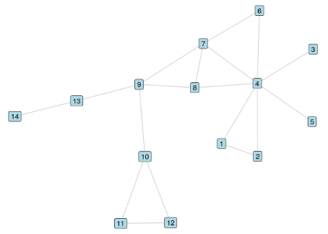




Introduction to Shortest Path Algorithms
Navigation Systems
Network Routing
Robotics
Game Development
Used in GPS and mapping applications to find optimal routes.
Crucial for efficient data transmission in computer networks.
Enables autonomous navigation and path planning for robots.
Powers AI pathfinding in video games for character movement.

Slide 38

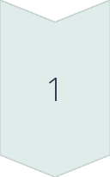
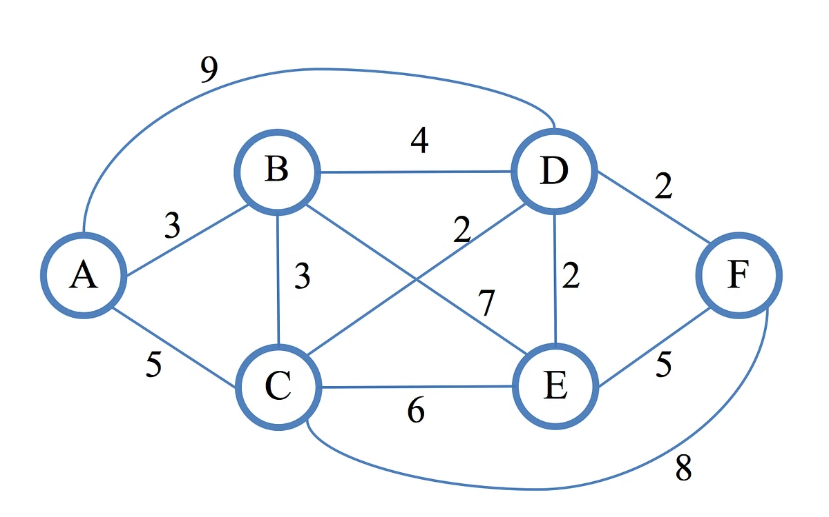
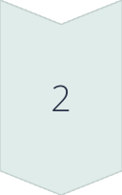
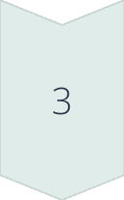
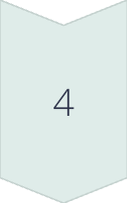
Dijkstra's Algorithm - Introduction
Initialize
Set distance to source as 0, all others as infinity.
Select Node
Choose unvisited node with smallest known distance.
Update Neighbors
Calculate distances through current node and update if shorter.
Mark Visited
Mark current node as visited and repeat from step 2.

Slide 39
Complexity and Applications of Dijkstra's Algorithm
Time Complexity
Practical Applications
Dijkstra's algorithm has a time complexity of O((V + E) log V). V represents vertices, E represents edges in the graph.
Dijkstra's algorithm is widely used in network routing protocols like OSPF and IS-IS. It optimizes paths in GPS navigation systems and traffic management.
This complexity arises from using a priority queue for efficient node selection. Heap operations contribute to the logarithmic factor.
The algorithm finds applications in robotics for path planning and in social networks for connection analysis.

Slide 40
Concusion
In summary, understanding different data structures and algorithms empowers us to select the best tools for specific programming challenges. By grasping the strengths and limitations of Stack, Queue, sorting methods, and shortest path algorithms, we can optimize data management and improve computational efficiency in real-world applications. We hope this presentation provides a clear foundation for applying these concepts in your own projects.

